Slide 1
La petite histoire de la méta-analyse

Slide 2
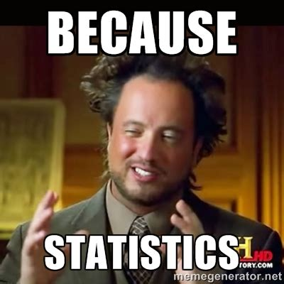
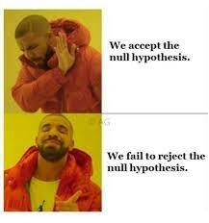
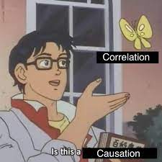
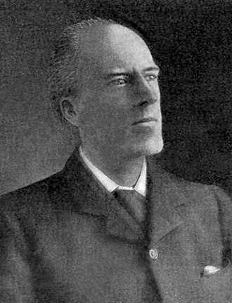
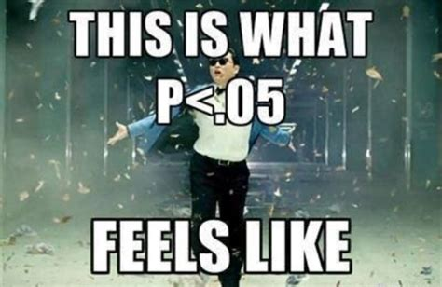
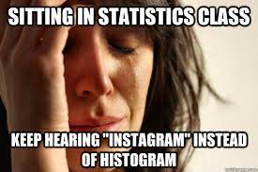
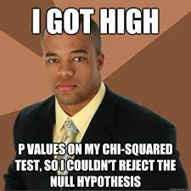

Slide 3
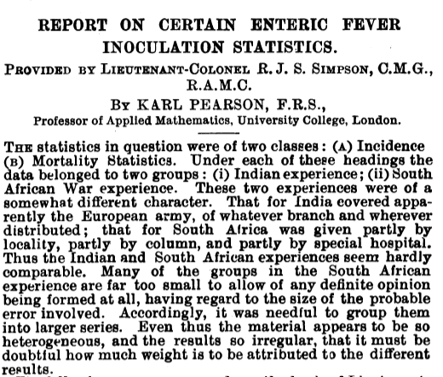
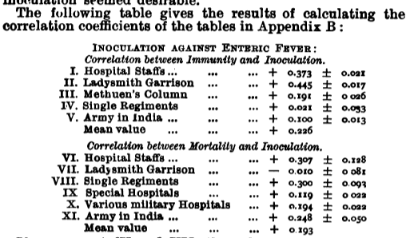
1904

Slide 4


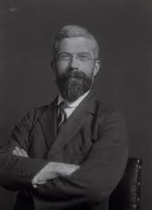

1935
Notes:
Fischer 1935 reported data showing that the use of fertiliser in agriculture is affected by the year and location

Slide 5
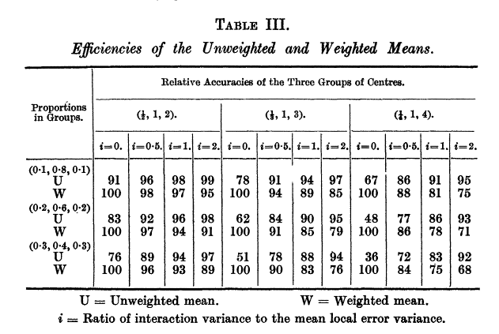
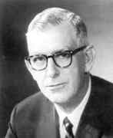
1937
Notes:
Cochran
First time someone propose a way to weight the means in an aggregation of effects.

Slide 6

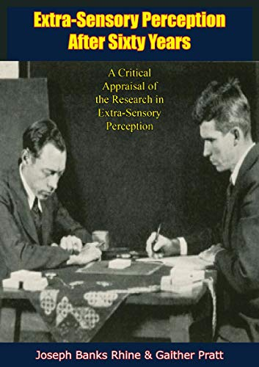

1940
Notes:
In chapter
4 they discuss and summarise ‘the full range of available trials made to test
the extrasensory perception hypothesis’ from experimental studies. They took a critical look
at the data from the point of view of the design and conditions of the
experiments to address general issues of whether the findings could have
happened by chance or by normal perception of sight, touch and hearing
by those involved in the experiment. They also considered experimental
errors and clustered results from similar experiments for subgroup analysis.
One of the approaches included in their review to
demonstrate the robustness of the analysis was an estimate of the
influence of unpublished papers on the overall pooled effect.
The work of Pratt and Rhine also sets a further
challenge for advocates of meta-analysis. They concluded, on the basis of
the evidence they summarised, that ESP did exist. Today we might
criticise their analysis for a series of problems with the underlying studies;
for some this was the design and conditions of the experiment, for others
there was both publication bias and probably some selective reporting.
The most important reason we are sceptical, however, is that, despite
attempts, the findings have not been replicable.

Slide 7
3 Conclusions
Confiance
Degré de liberté
Replications > Meta-analyses
L'image créée par l'accumulation de résultats de recherche au fil du temps peut systématiquement présenter une vue incomplète ou biaisée.
Il y a des défenseurs de la perception extrasensorielle et, plus largement, de la parapsychologie, qui tentent de convaincre la communauté scientifique que la perception extrasensorielle est un phénomène authentique.
La parapsychologie n’a pas tenue la réplication
Notes:
Trust : trust in the published studies

Slide 8







Slide 9
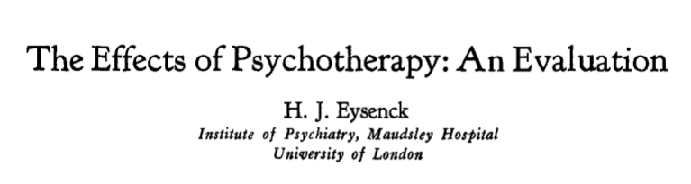
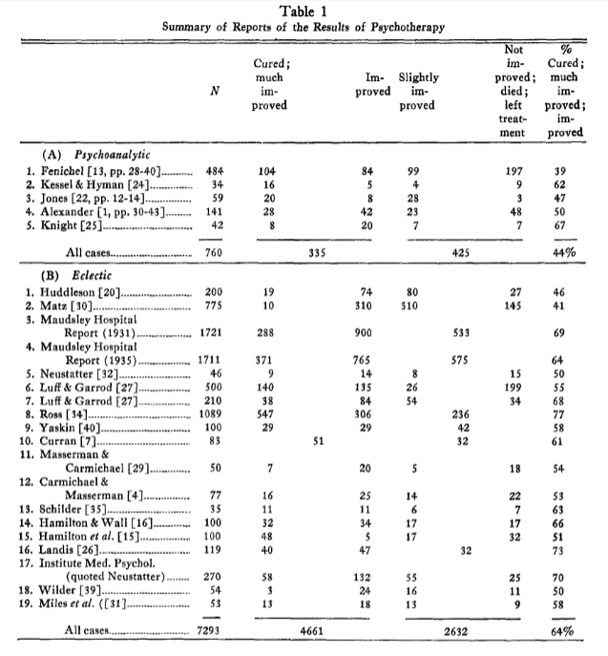
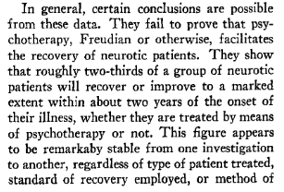
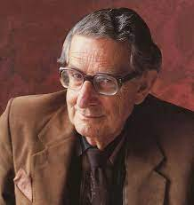
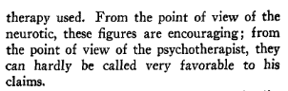
1952

Slide 10

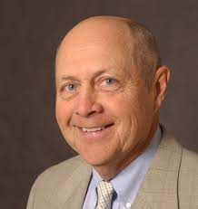
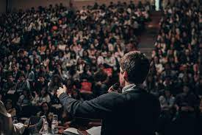
1967
‘ Meta-analyse ’
‘the statistical analysis of a large collection of analysis results from individual studies for the purpose of integrating the findings’
Notes:
Gene Glass

Slide 11


Slide 12
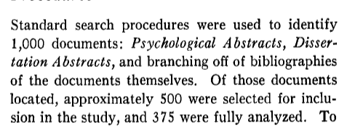
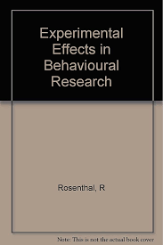
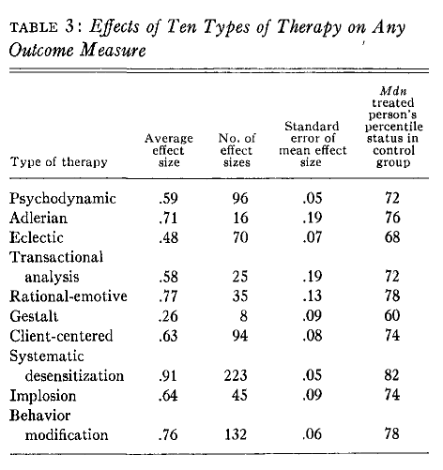
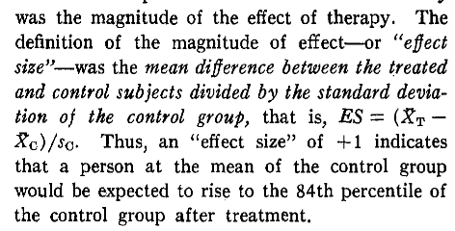
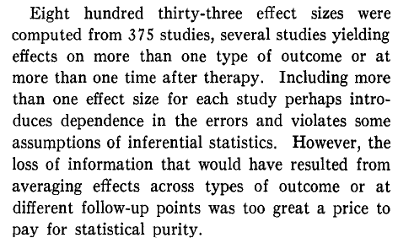
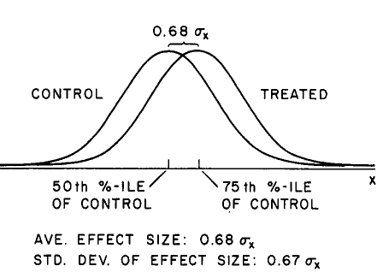
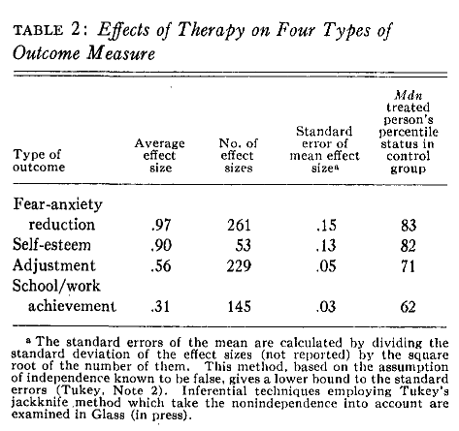
1977
Notes:
Gene Glass credits Robert Rosenthal for developing the underlying
metric of ‘effect size’ or the use of standard deviation units which are
the measure used in most educational meta-analyses of impact studies
that we now call ‘meta-analysis’. In 1966, Rosenthal had published
a book entitled Experimenter Effects in Behavioral Research, which
contained calculations of a large number of standardised mean differences
(‘effect sizes’) that he then compared across domains or conditions.

Slide 14
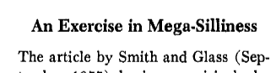
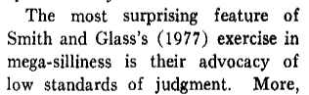
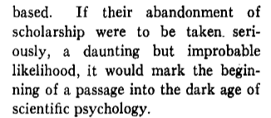
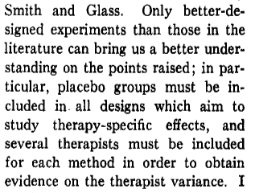
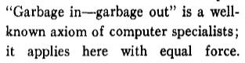
1978

Slide 15
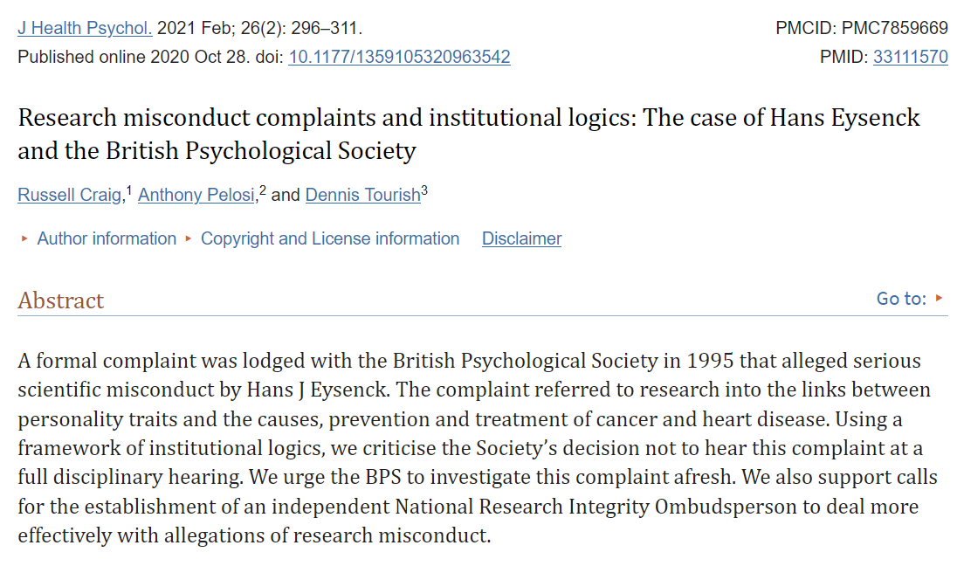
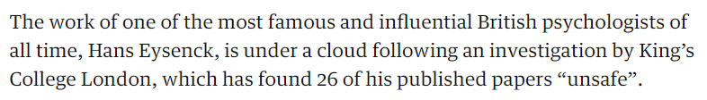

Slide 16
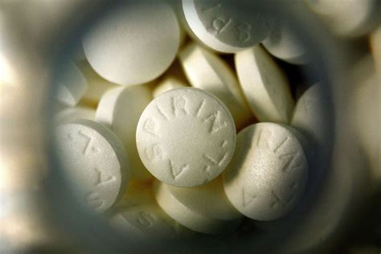
Notes:
randomised trial conducted by Peter Elwood, Archie
Cochrane and others (Elwood et al., 1974) to find out whether taking
aspirin lowered the risk of further heart attacks and reduced the mortality
rates associated with these
The overall results
suggested there was a benefit but were not conclusive. So, over the next
few years, Elwood and Cochrane collected and combined results using
meta-analysis as additional findings from new trials were reported.
This aggregation left little room for doubt that taking aspirin after
a heart attack was beneficial, and the findings were presented in 1980 but penned by the British medical
statistician Richard Peto.
Peto and his colleagues used a further example with data from randomised
trials of beta-blockers following heart attack to encourage
medical practitioners to consider aggregation of data from randomised
trials systematically and to combine quantitative estimates of the effects
of comparable medical treatments.
These developments started
a debate, similar to one developing in the social sciences, about the
best way mathematically to ‘average’ or estimate the aggregated findings
in a single figure estimating the overall impact of different interventions
or treatments, as an effect size.

Slide 17
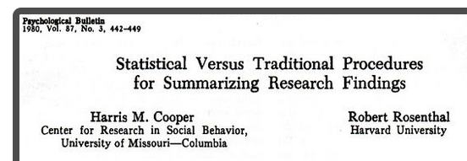
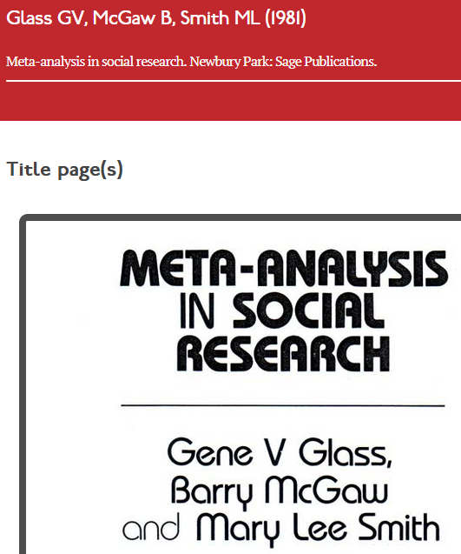
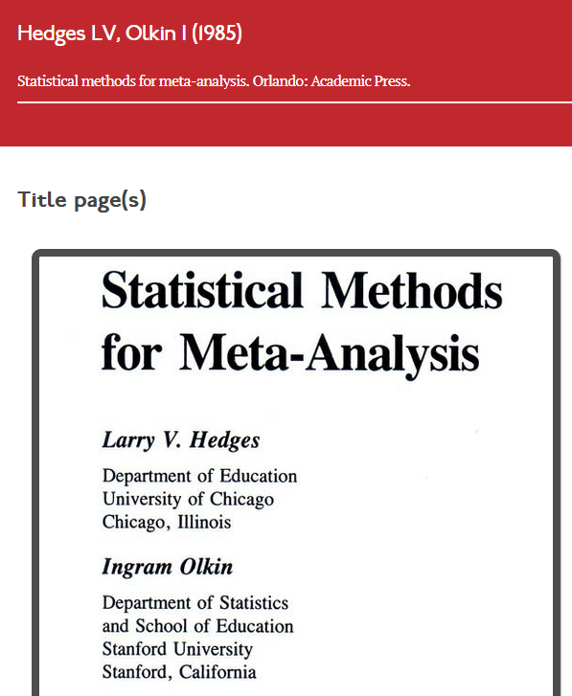
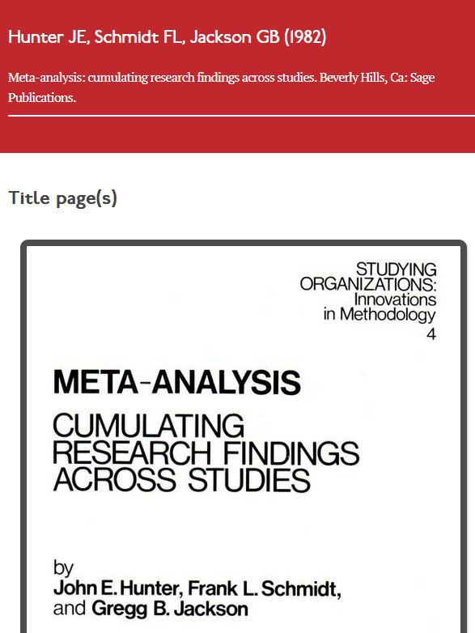
Notes:
Larry Hedges 1983
Rebecca DerSimonian & Nan Laird 1986
-> Random effect and taking into account within study variance

Slide 18
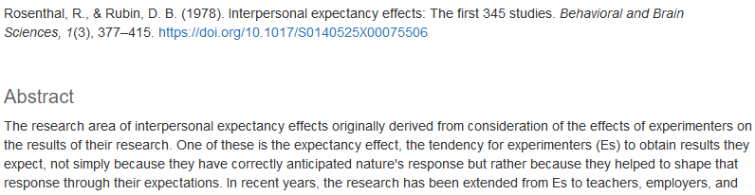
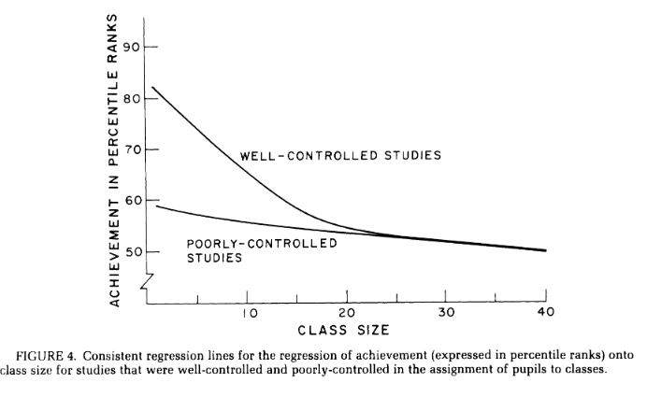
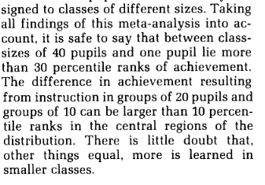
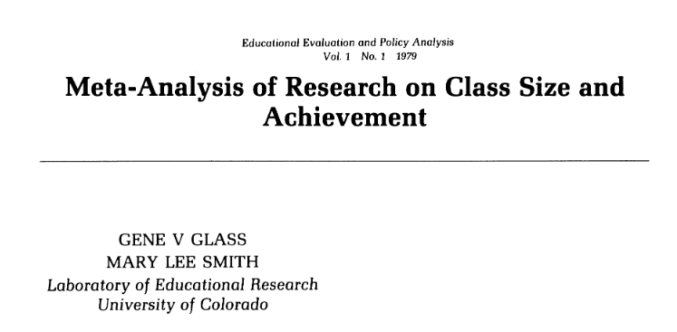
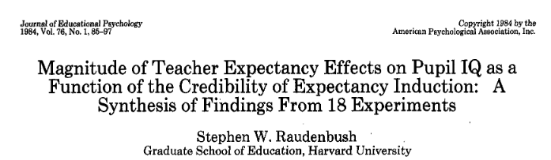
Notes:
Larry Hedges 1983
Rebecca DerSimonian & Nan Laird 1986
-> Random effect and taking into account within study variance

Slide 19

1993
Notes:
randomised trial conducted by Peter Elwood, Archie
Cochrane and others (Elwood et al., 1974) to find out whether taking
aspirin lowered the risk of further heart attacks and reduced the mortality
rates associated with these
The overall results
suggested there was a benefit but were not conclusive. So, over the next
few years, Elwood and Cochrane collected and combined results using
meta-analysis as additional findings from new trials were reported.
This aggregation left little room for doubt that taking aspirin after
a heart attack was beneficial, and the findings were presented in 1980 but penned by the British medical
statistician Richard Peto.
Peto and his colleagues used a further example with data from randomised
trials of beta-blockers following heart attack to encourage
medical practitioners to consider aggregation of data from randomised
trials systematically and to combine quantitative estimates of the effects
of comparable medical treatments.
These developments started
a debate, similar to one developing in the social sciences, about the
best way mathematically to ‘average’ or estimate the aggregated findings
in a single figure estimating the overall impact of different interventions
or treatments, as an effect size.

Slide 20
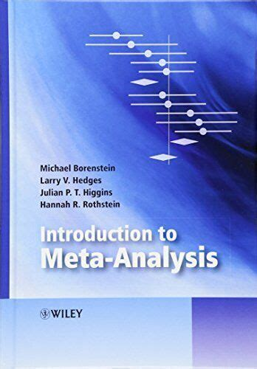
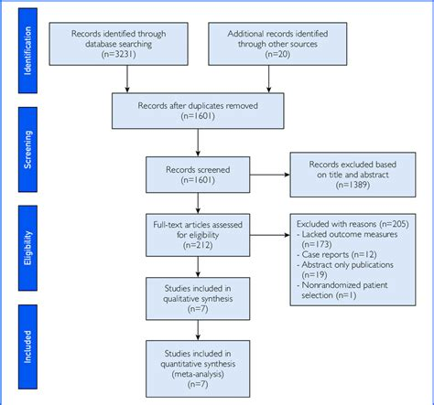
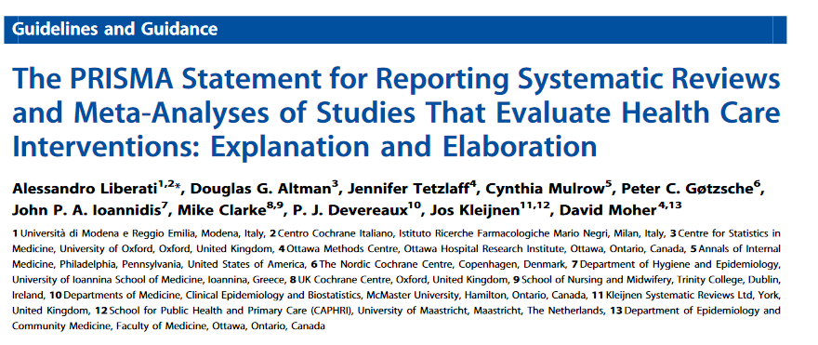
2009

Slide 21
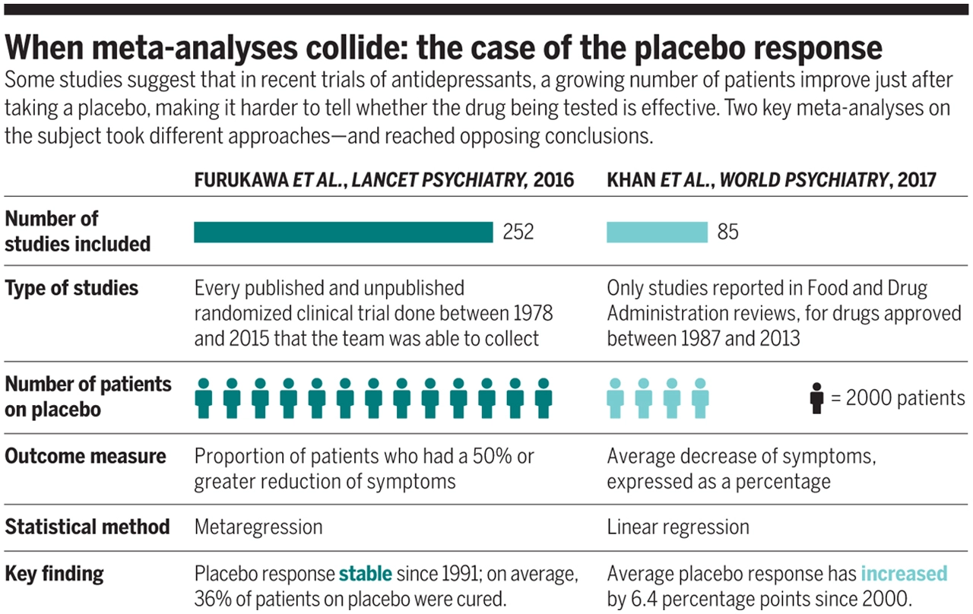
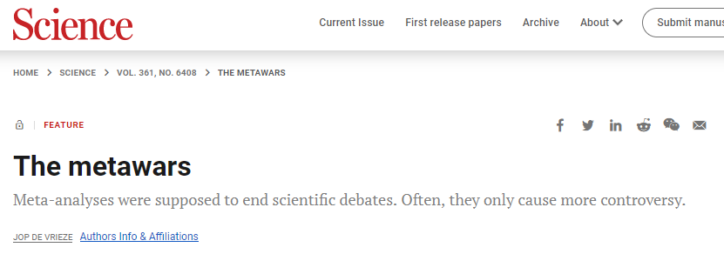
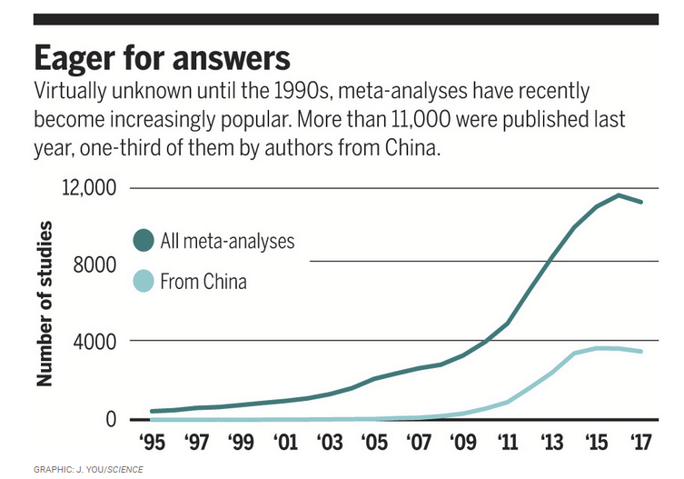


2017
Notes:
Yet the hundreds of scientific studies that have explored whether media violence can lead to aggressive thoughts and actions have produced conflicting results. That's why scientists have resorted to meta-analyses, studies that collect all the evidence about a scientific question, weigh it impartially, and declare a winner.

Slide 22



2017
Notes:
Yet the hundreds of scientific studies that have explored whether media violence can lead to aggressive thoughts and actions have produced conflicting results. That's why scientists have resorted to meta-analyses, studies that collect all the evidence about a scientific question, weigh it impartially, and declare a winner.

Slide 23




Slide 24




2021

Slide 25
Et maintenant ?

Slide 26






Slide 27



Slide 28
3 Conclusions
Confiance
Degré de liberté
Replications > Meta-analyses
L'image créée par l'accumulation de résultats de recherche au fil du temps peut systématiquement présenter une vue incomplète ou biaisée.
Il y a des défenseurs de la perception extrasensorielle et, plus largement, de la parapsychologie, qui tentent de convaincre la communauté scientifique que la perception extrasensorielle est un phénomène authentique.
La parapsychologie n’a pas tenue la réplication
Notes:
Trust : trust in the published studies

Slide 29







Every talk should start with...
Notes:
https://www.washingtonpost.com/news/speaking-of-science/wp/2015/08/28/no-sciences-reproducibility-problem-is-not-limited-to-psychology/?noredirect=on&utm_term=.1f3faa914cc1
https://www.enago.com/academy/the-reproducibility-crisis-in-chemistry/
https://www.chemistryworld.com/news/taking-on-chemistrys-reproducibility-problem/3006991.article
http://www.slate.com/articles/health_and_science/future_tense/2016/04/biomedicine_facing_a_worse_replication_crisis_than_the_one_plaguing_psychology.html
https://www.nationalreview.com/2017/11/research-replication-crisis-growing-problem/
https://theconversation.com/the-replication-crisis-has-engulfed-economics-49202
https://dl.acm.org/doi/10.1145/3360311
https://www.nature.com/articles/d41586-021-00954-8

Slide 30




Collaborative mass replications
2015
Aug 2018
Nov 2018

Slide 31
My unofficial summary of Social Psychology status:
~30-50% replication rate.
In what replicates, effect sizes ~1/2 of original.

Slide 32


3 Conclusions
Confiance
Degré de liberté
Replications > Meta-analyses
L'image créée par l'accumulation de résultats de recherche au fil du temps peut systématiquement présenter une vue incomplète ou biaisée.
Il y a des défenseurs de la perception extrasensorielle et, plus largement, de la parapsychologie, qui tentent de convaincre la communauté scientifique que la perception extrasensorielle est un phénomène authentique.
La parapsychologie n’a pas tenue la réplication
Notes:
Trust : trust in the published studies

Slide 33

3 Conclusions
Confiance
Degré de liberté
Replications > Meta-analyses
L'image créée par l'accumulation de résultats de recherche au fil du temps peut systématiquement présenter une vue incomplète ou biaisée.
Il y a des défenseurs de la perception extrasensorielle et, plus largement, de la parapsychologie, qui tentent de convaincre la communauté scientifique que la perception extrasensorielle est un phénomène authentique.
La parapsychologie n’a pas tenue la réplication
Notes:
Trust : trust in the published studies

Slide 34
3 Conclusions
Confiance
Degré de liberté
Replications > Meta-analyses
L'image créée par l'accumulation de résultats de recherche au fil du temps peut systématiquement présenter une vue incomplète ou biaisée.
Il y a des défenseurs de la perception extrasensorielle et, plus largement, de la parapsychologie, qui tentent de convaincre la communauté scientifique que la perception extrasensorielle est un phénomène authentique.
La parapsychologie n’a pas tenue la réplication
Notes:
Trust : trust in the published studies

Slide 35




